Slide 1
Recipe Sharing Website
An ActivityPub Implementation

Slide 2
Agenda
Statement of Purpose
User Personas
Topics of Risks and Rabbit Holes
Details
The fat-marker sketches
Iteration skeleton
Wireframe
Roadmap

Slide 3
Statement of Purpose
Iteratively develop a user-serving, reliable and scalable recipe-sharing social media platform directed primarily toward grad students. It will cater to dietary restrictions and promote cultural diversity in its shared recipes. It aims to build meaningful bonds based on shared culinary enthusiasm .

Slide 4
User Personas
Users who:
Are short on time and looking to enhance simple cooking
Are less financially able to spend at restaurants and other eateries
Would like to making cooking a more social experience
**Graduate students fit this typecast!

Slide 5
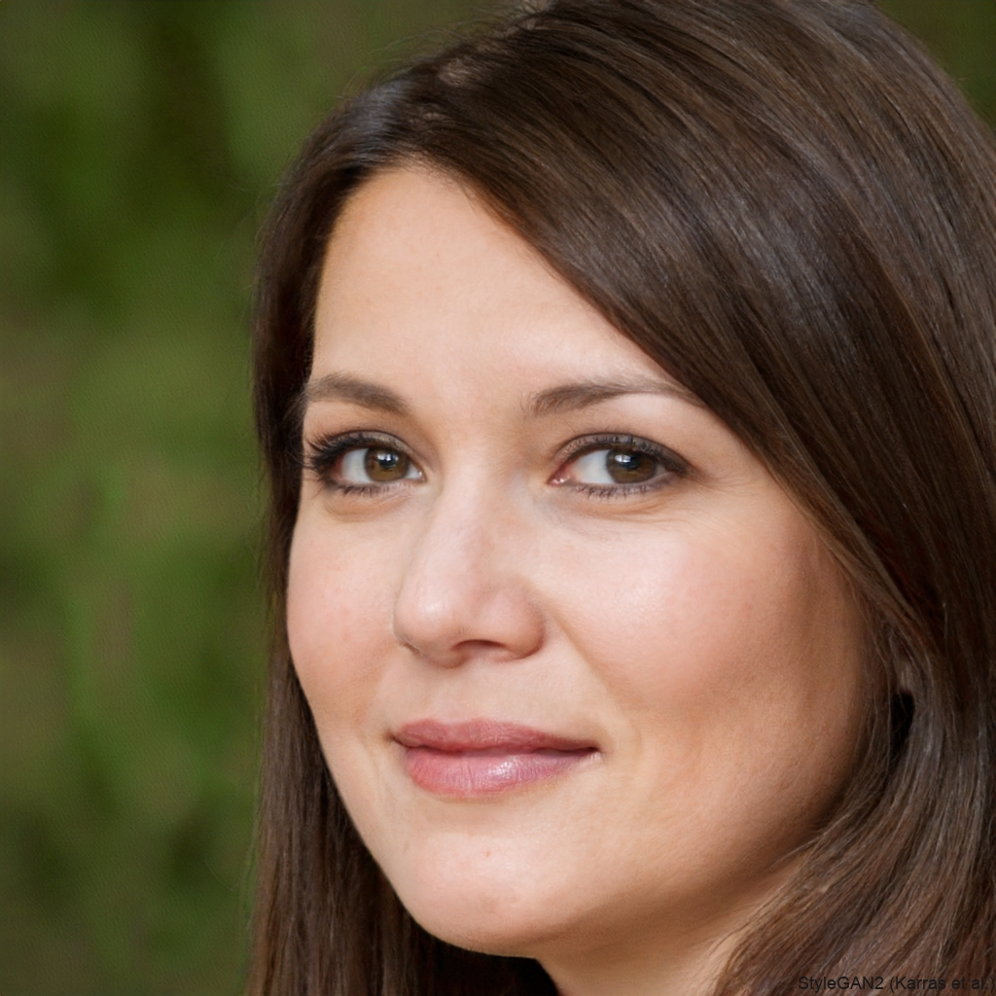
User Persona: Charlotte Parker
Age: 28
Occupation: Biology PhD Candidate
Core Needs:
Time-Efficient Recipes: As a PhD candidate who has to juggle studying, lab work, and socializing, Charlotte needs ways to discover quick and simple recipes that worked for her peers in similar living situations
Health and Environmental Consciousness: As a vegetarian who is also trying to maintain an environmentally-friendly and nutritious diet, she needs to be able to sort recipes with these criterias with ease
Cooking as a Mother: As a young mother, Charlotte would also want recipes for her children that are popular in her demographic

Slide 6
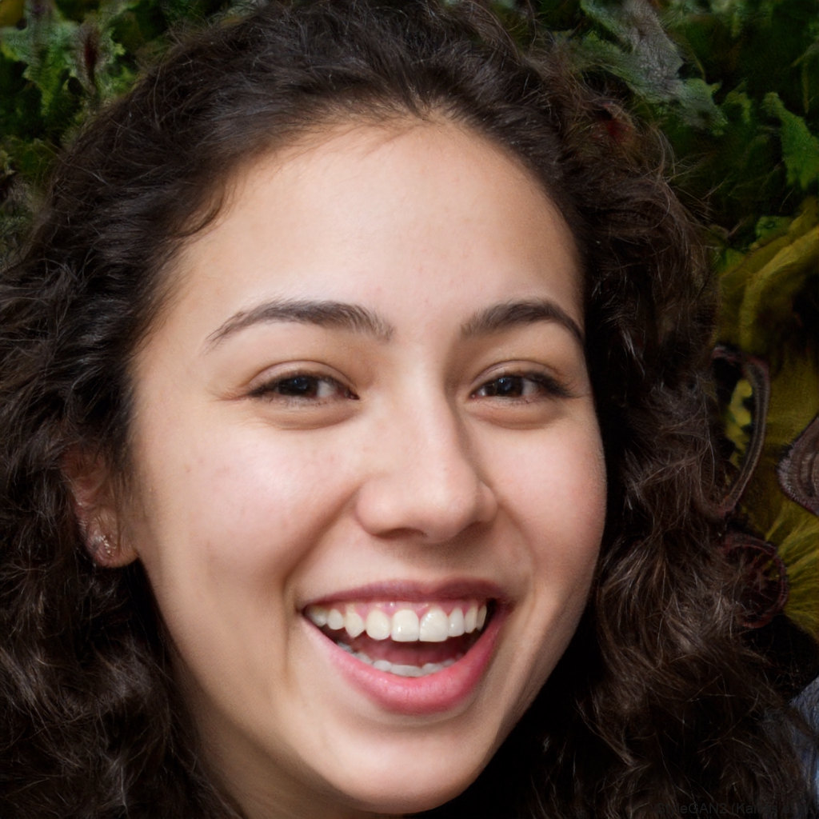
User Persona: Caroline Ghahary
Age: 23
Occupation: Chemical Engineering Masters Student
Core Needs:
Food Prep: As someone who is constantly on the move, Caroline needs recipes that she can cook at once but will last her several meals which she can take as packed meals
Saving and Sharing: As a social person, Caroline loves to send recipes to her friends but also keep them somewhere where she can access them quickly herself
Cultural Food Inclusion: As someone with an interest in various cuisines, she wants to use this platform to better understand those cultures by attempting cooking exotic dishes

Slide 7
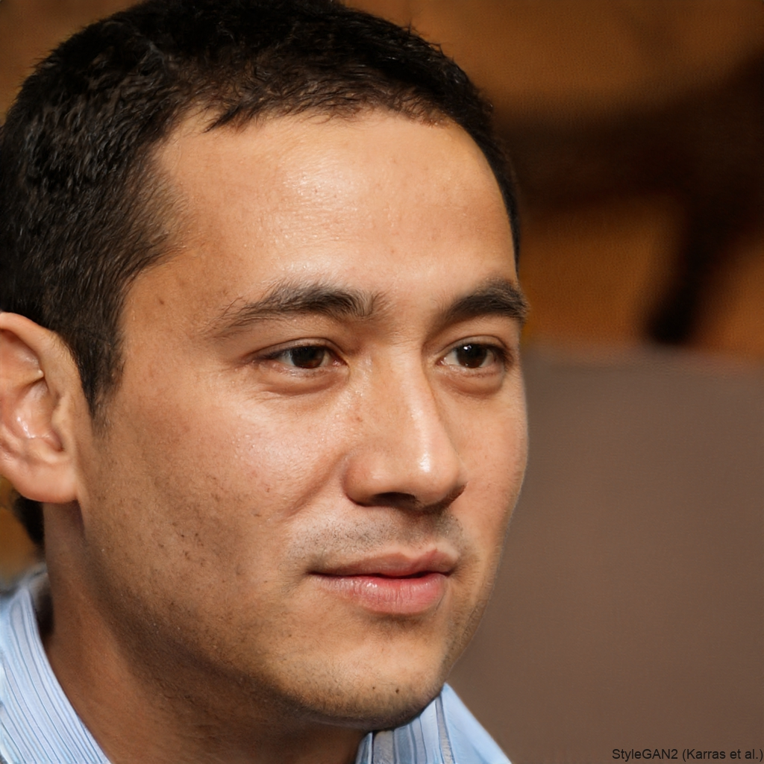
User Persona: Dan Akhmetov
Age: 31
Occupation: Software Engineer at Meta
Core Needs:
Portion Control: Dan spends most of his day in front of a computer, so he needs recipes to accurate data on nutritional values to ensure he stays in shape
Code-Friendly Snacks: As a software engineer, Dan would prefer to use the recipe app to make things he can eat while doing work over time-consuming, full-sized meals
Discussion: As someone who frequently browses review sites and online discussion forums, Dan would want some comment and rating integration to see how people respond to certain recipes and to unlock extra tips

Slide 8
Risks and Rabbit Holes
Not catering to dietary restrictions (eg. vegan, lactose intolerant, gluten-free)
Lacking cultural/religious diversity in recipes
Enforcing user integrity with regard to recipe ownership*
Not standardizing recipe quality and format
Users with different levels of culinary experience may tend to use different language in their recipes rather than something universally understood (eg. handful of rice vs 2 cups)
Not having a robust and easily-understood rating and review system

Slide 9
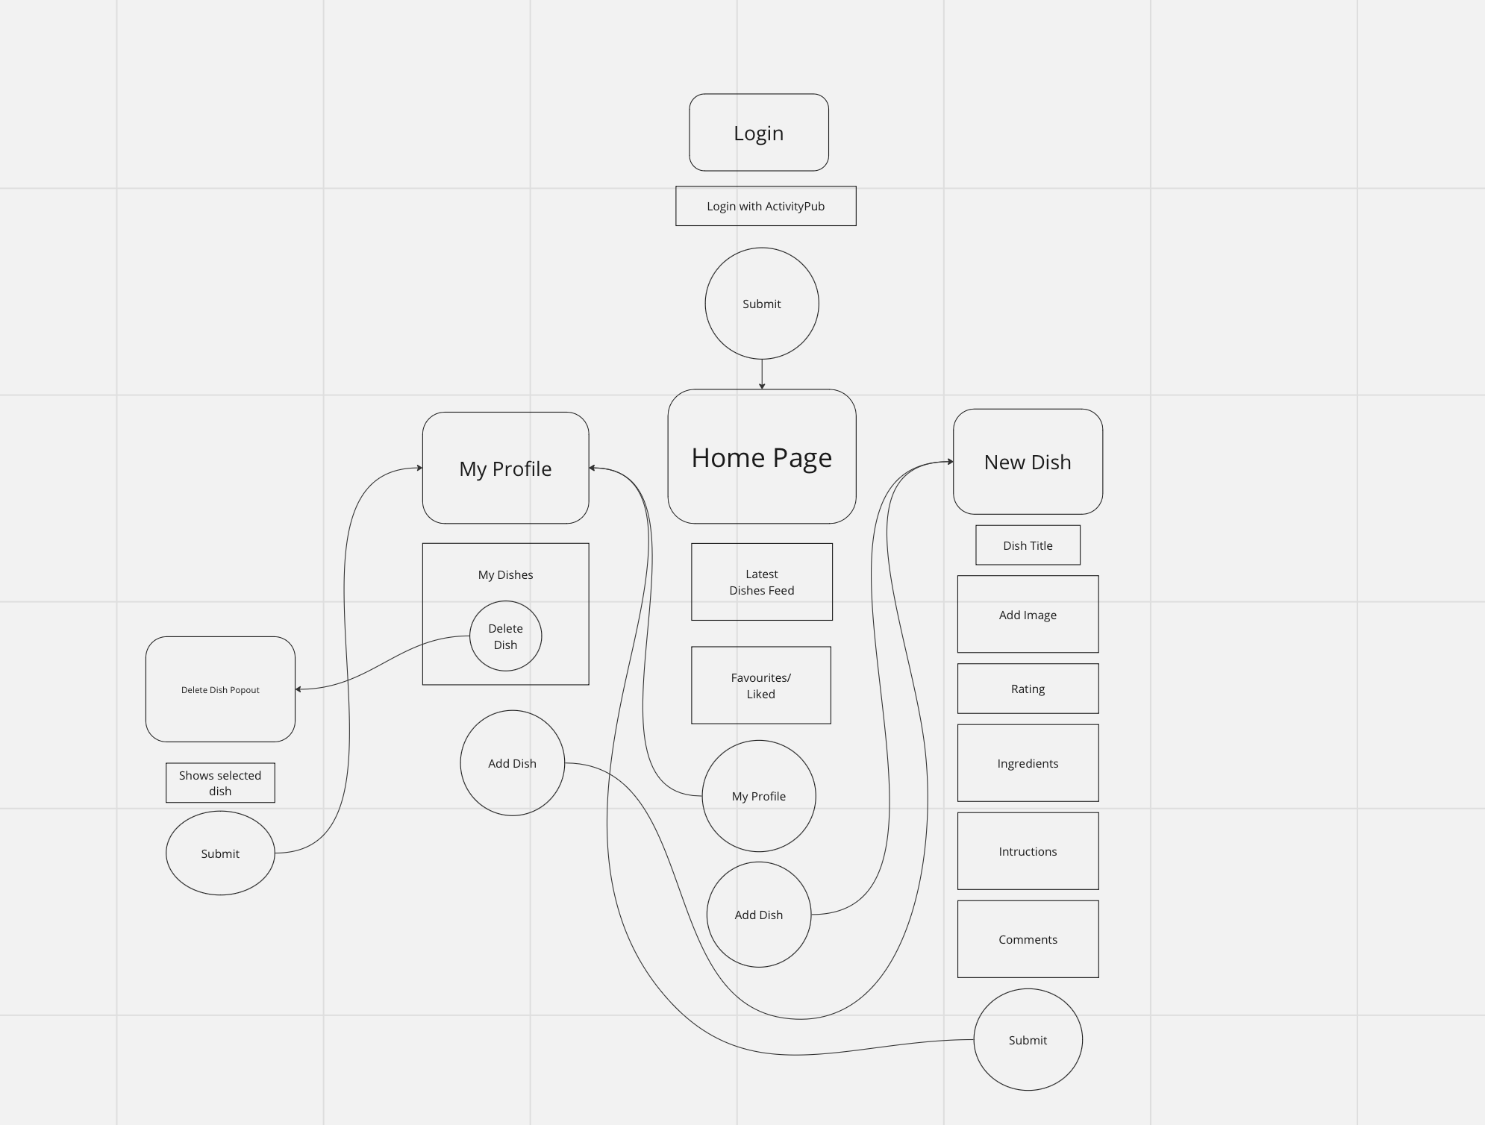
Details - Interactions Skeleton
We have 4 main pages - login, home, profile page, and new dish.
Pages are shown in rounded boxes.
Circles are buttons and have associated connections to pages.
Rectangles are elements on each page.

Slide 10
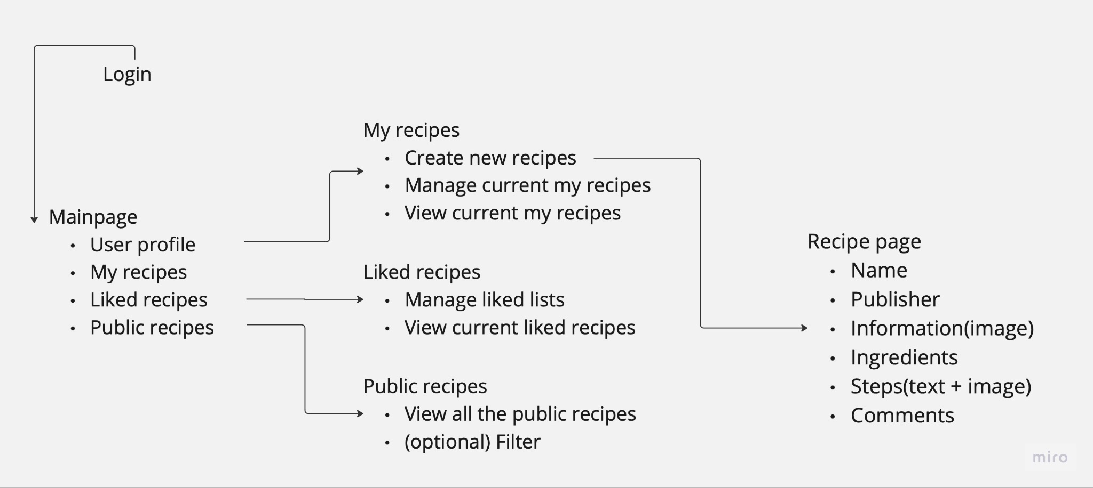
Details - Fat-marker

Slide 11
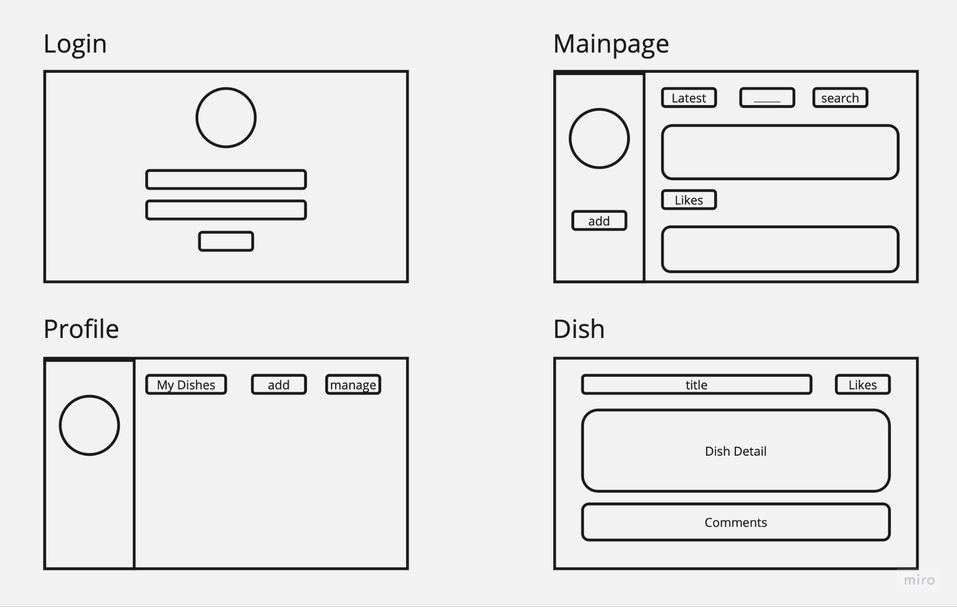
Details - Wireframe
Notes:
https://miro.com/welcomeonboard/R3FFbGdyd3ExR3AwaWxSVFdCQTJZR0R2aE9Wdm4xNkVwTmRMbmkzQ0I3eUUzckVTYTVmY29renMxNzRiU05FNnwzNDU4NzY0NTY4NTU0NDUyMzYzfDI=?share_link_id=130646975703

Slide 12
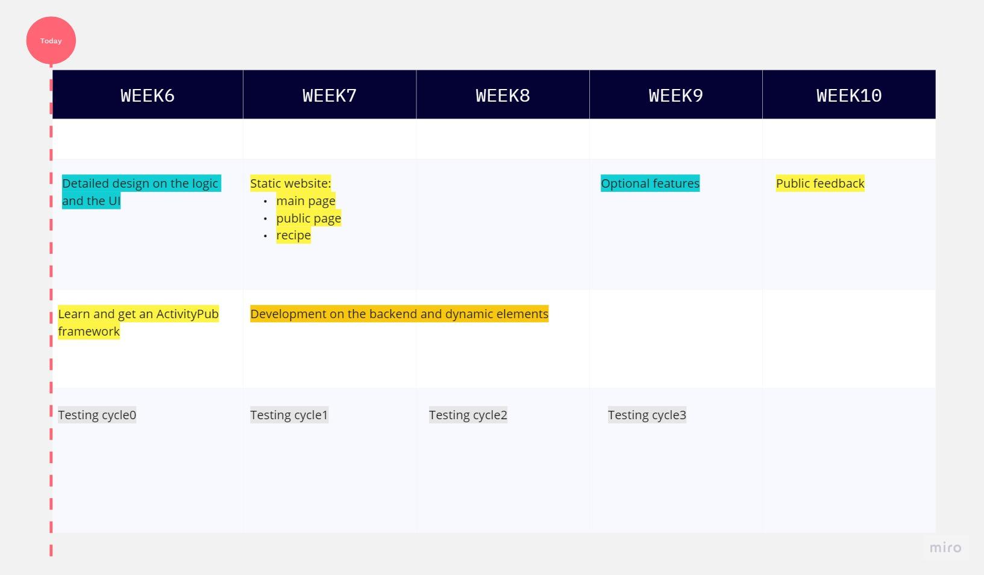
Roadmap
In total 5 weeks - from week 6 to week 10.

Slide 13


